Slide 1
Continual Learning Techniques for Image Classification
Finlay Boyle
Supervised by Dr Donald Sturgeon
Durham University, Department of Computer Science
Notes:
Continual Learning Techniques for Image Classification

Slide 2
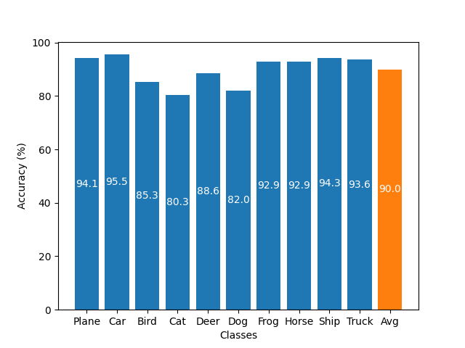

Training Machine Learning Models
Standard training technique: Offline Training
Repeated optimisation over batches
Requires access to entire dataset
High-quality results
Limitations:
Restrictive dataset requirement
Suffers from Catastrophic Forgetting
Figure 1: Offline Training on CIFAR-10 for 100 epochs
TODO: Update
Figure 2: 20 random 32x32 image samples from CIFAR-10

Slide 3
Catastrophic Forgetting
Catastrophic Forgetting: The complete and sudden loss of previously acquired knowledge in a neural network [1]
Sequentially updating with new data causes forgetting
Offline Training lacks context of prior knowledge
Ability to learn continually often ignored [2]
[How do we measure this?]

Slide 4
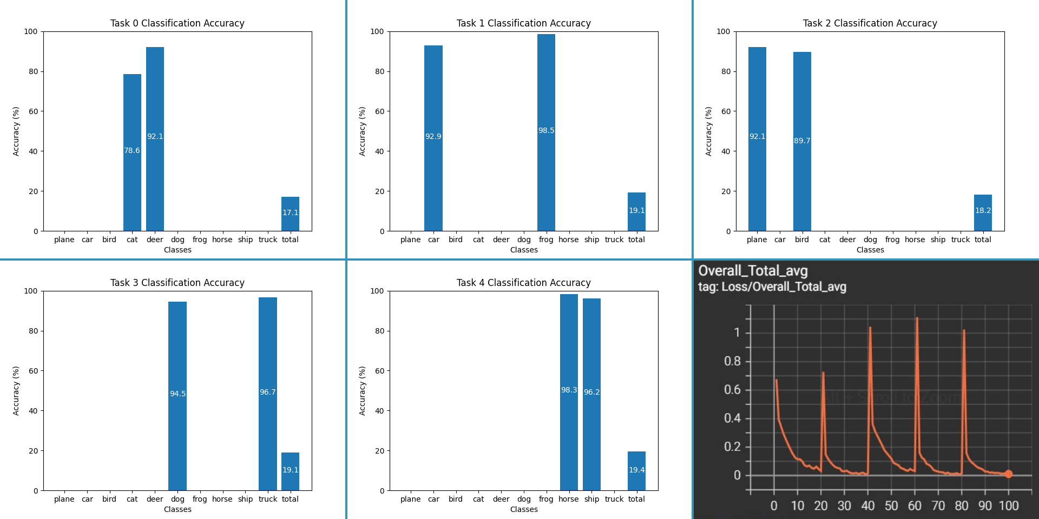
Example of Catastrophic Forgetting
Figure 3: Applying Offline Training sequentially to the same model with separate tasks causes Catastrophic Forgetting. Bottom right: Overall loss. Other images are classification accuracy.
Notes:
In this example, I have split the CIFAR-10 dataset into 5 disjoint tasks, each containing 2 classes without replacement. A ResNet-18 model is then trained sequentially on the tasks for 20 epochs each. [Use Laser] as you can see in Figure 3, the model forgets about the previous tasks and overwrites the knowledge.
The final graph shows the loss peaking as each new task is introduced and decreasing as the model is trained.
To-do: change the image with the updated version

Slide 5
Continual Learning
Continual Learning: A collection of techniques to overcome Catastrophic Forgetting [3]
Rose to prominence with Elastic Weight Consolidation in 2017 [4] and is actively researched
Primarily focused on alternative methods to Offline Training
Smaller focus on network architecture [5] and dynamic networks
Does not require access to entire dataset
Notes:
Continual Learning is the study of techniques to reduce the effect of Catastrophic Forgetting while trying to match the performance of Offline Training. Elastic Weight Consolidation, a technique that penalises changes to weights that are important to previous tasks, was one of the first techniques that gave rise to the field.
The literature since then has mainly focused on alternatives to Offline Training, but there has been a recent interest into how the architecture of a model may contribute to forgetting. The main difference from Offline Training is the relaxation of the requirement for the whole dataset to be present at training time.

Slide 6
Properties
Task Formulation: Divide the dataset into subsets and process these sequentially
Disjoint vs. Blurry: Disjoint tasks have no overlapping classes or samples
Online vs. Offline: In the online case, we can only see each sample
Task Incremental vs. Class Incremental:
Task Incremental: At test time, model is given which task a sample belongs to
Class Incremental: At test time, the model has to determine the task itself

Slide 7
Existing Approaches
Memory-Based
L2P
SCR
Co2L
GSS
GDumb
DER
DER++
Rainbow
iCaRL
LNIDA
ASER
MIM
FearNet
MIR
REMIND
RCL
DGR
ACAE-REMIND
LUCIR
A-GEM
MER
GEM
La-MAML
Drift
RWalk
Mnemomics
EWC
E2E
Hindsight Anchors
SI
NFR
OML
FLP
LwF
MERLIN
Regularisation
Meta Learning
Notes:
Venn Diagram of Regularisation, Memory, Meta-Learning
Why meta-learning isn’t useful in the online context
Highlight those that influence my technique

Slide 8
Techniques Influencing Design
L2P: Introduced use of Pre-trained Vision Transformers (ViT) to Continual Learning
Current State of the Art results
GDumb: Stores a subset of data to train a classifier
Excellent benchmark in the literature
Rainbow: Quantifies model uncertainty with respect to specific samples
Uses image augmentations to achieve this
SCR: Introduced Supervised Contrastive Learning (SCL) loss to Continual Learning
SCL loss encourages class clustering in feature space

Slide 9
Pre-trained Vision Transformers
Large-scale pre-trained model
Used in L2P with trainable prompts
I use them as a versatile feature extractor
Notes:
Why use them?
Do they defeat the point of Continual Learning → No
How are they used in L2P and how does mine differ?

Slide 10
Classification Methods
Nearest Class Mean
Softmax
Average the feature vectors in memory
Compute distance from sample to mean class vectors
Closest mean determines class
Requires feature space clustering
Map output from the model to a probability distribution
Maximum determines class

Slide 11
Loss Functions
Supervised Contrastive Loss
Cross Entropy Loss
Used in SCR
Encourages classes to cluster in feature space
Naturally NCM favours this setup
Alternative to CE loss
Encourages separation of feature space cluster
Measure difference from expected probability distribution
Unpredictable feature space
Good for typical multi-class classification
Notes:
NCM classification vs (Soft)max classification
Why does SCL loss work well with NCM
Quick overview of CE loss?

Slide 12
Memory Buffer
Store samples for reuse later
Have a fixed upper limit of samples
Dynamically allocate space to different image classes
How to determine which samples to store?
Rainbow introduced uncertainty based selection

Slide 13
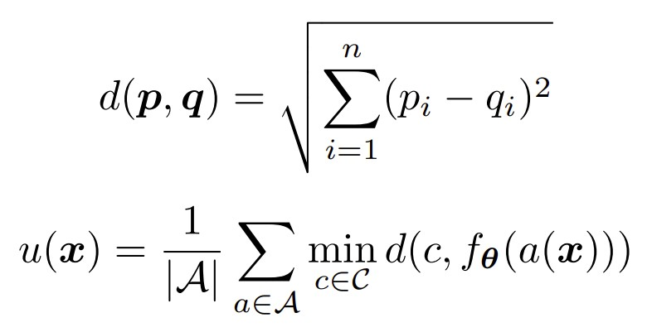
Populating the Memory Buffer
Utilising NCM classification
Propose to make use of the distances in the feature space to quantify uncertainty
Use an improved version of Rainbow uncertainty
Normalise uncertainty over each batch
Given a set of augmentations A, a set C of class means, and a model f_theta, score samples as:
Notes:
Rainbow introduced uncertainty
Introduce Novel-BN
Why Batch Normalisation might be problematic (especially in CL context)

Slide 14

An Alternative Approach
Problem with previous approach: Batch Normalisation
Due to tasks, batches may not be representative
Feature space density is not uniform
Instead take ratio of distance to the closest two means
Intrinsic normalisation to [0, 1]
Let d_1 and d_2 be the distance to the closest and second closest mean:
Notes:
Add comparison table from paper

Slide 15
Summary of the Novel Approach
Use a pre-trained ViT backbone
With an attached MLP head
Balanced, fixed maximum memory buffer
Two distinct approaches uses the two selection strategies
Use NCM classification with SCL loss
Train for 70 epochs per task

Slide 16
Experiment Setup
Each experiment is repeated 5 times for reliability
Record classification metrics and resource consumption metrics
Utilise both CIFAR-10 and CIFAR-100
Conduct experiments across variety of maximum buffer sizes
200, 500, 1000, 2000, and 5000

Slide 17
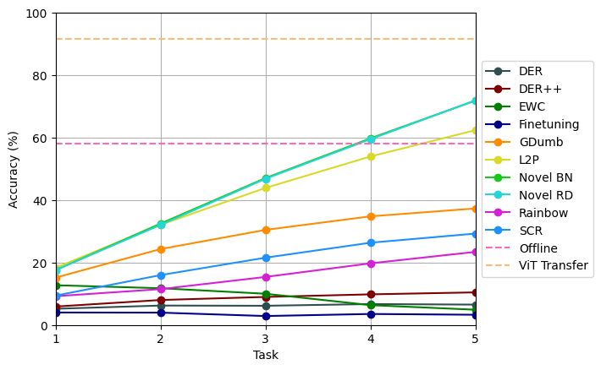
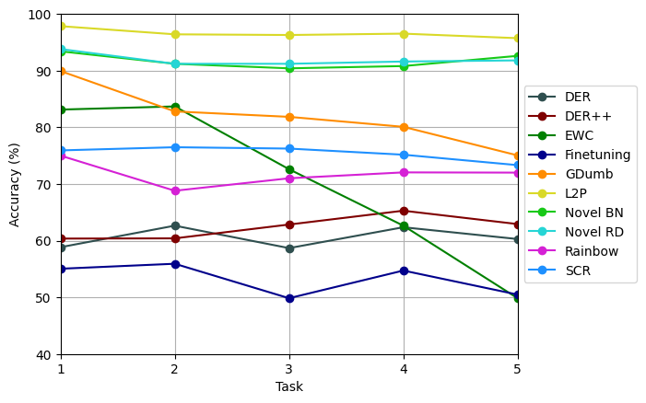
Results on CIFAR-100
Notes:
Highlight key results
Make some comparisons

Slide 18
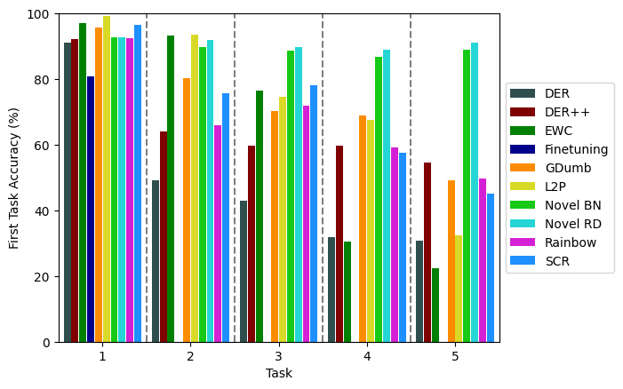
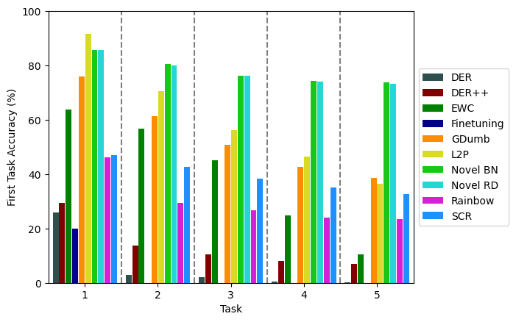
First Task Forgetting
Notes:
Highlight key results
Make some comparisons

Slide 19
Conclusion
Novel approach builds upon existing literature
Introduces an improved method to quantify sample uncertainty
Capable of outperforming state-of-the-art
Future work may focus on:
Further exploration of ViT applications in Continual Learning
Class-imbalanced memory buffers supported by uncertainty
Carefully tailored image augmentations

Slide 20
References
[1] McCloskey, Michael, and Neal J. Cohen. "Catastrophic interference in connectionist networks: The sequential learning problem." Psychology of learning and motivation. Vol. 24. Academic Press, 1989. 109-165.
[2] Hecht-Nielsen, Robert. "Neurocomputing: picking the human brain." IEEE spectrum 25.3 (1988): 36-41.
[3] Parisi, German I., et al. "Continual lifelong learning with neural networks: A review." Neural Networks 113 (2019): 54-71.
[4] Kirkpatrick, James, et al. "Overcoming catastrophic forgetting in neural networks." Proceedings of the national academy of sciences 114.13 (2017): 3521-3526.
[5] Mirzadeh, Seyed Iman, et al. "Architecture matters in continual learning." arXiv preprint arXiv:2202.00275 (2022).
Notes:
Thank you for listening, here are the references for the presentation.

Slide 21
Results on CIFAR-10
Same style as the CIFAR-100 main slide, gives a summary
Mainly focused on showing figures rather than raw data
Highlight a few key results

Slide 22
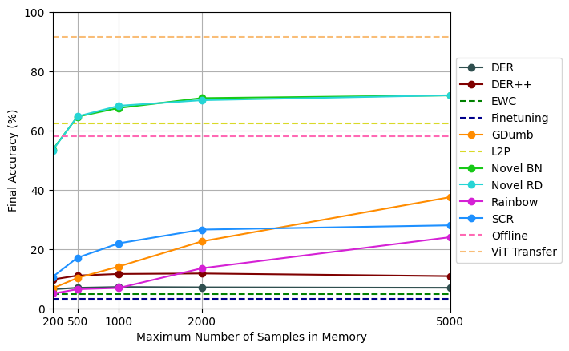
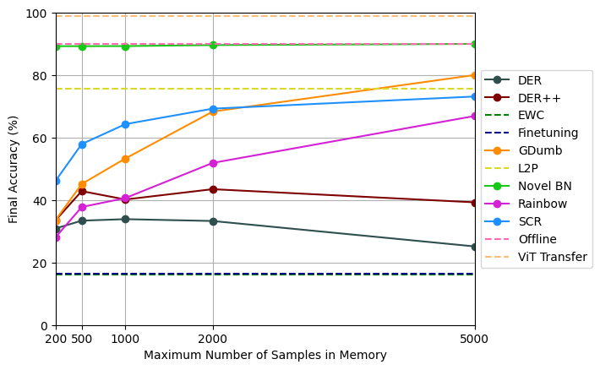
Results with Varied Buffer Sizes
Notes:
Figures from the main report showcasing the increase in performance as more samples are introduced
Talk about SCR plateauing etc

Slide 23
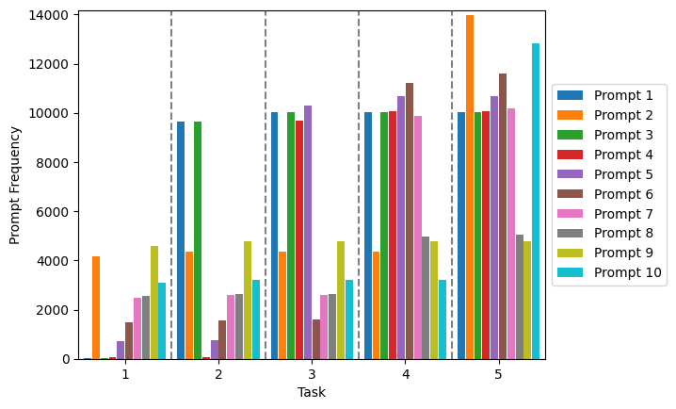
Analysis of L2P Prompt Saturation
Notes:
L2P prompt usage figures
What do they show?
Link with the fall off in first-task performance
Link with catastrophic forgetting

Slide 24
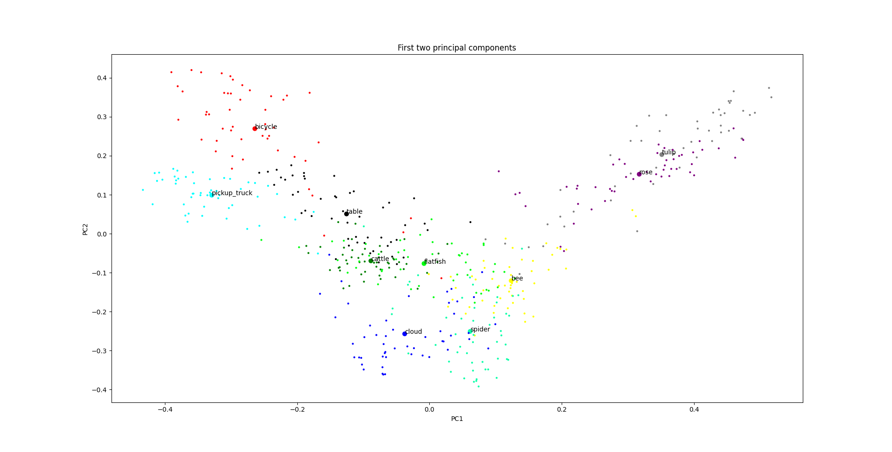
Analysis of Feature Spaces
PCA graphs of the feature space

Slide 25
Analysis of Resource Consumption
Comparison of run time
Comparison of memory consumption
Trade-off with results
Might be better to just merge this with the results and have some info to talk about instead?

Slide 26
Further Justification for Novel-RD
Might not be needed
Will decide based on how in-depth I go in the main presentation

Slide 27
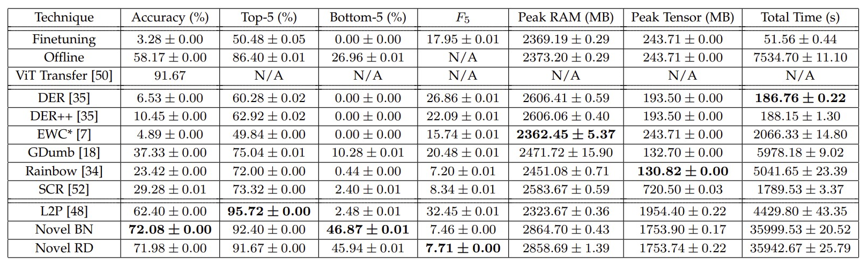
Full Results from CIFAR-100

Slide 28
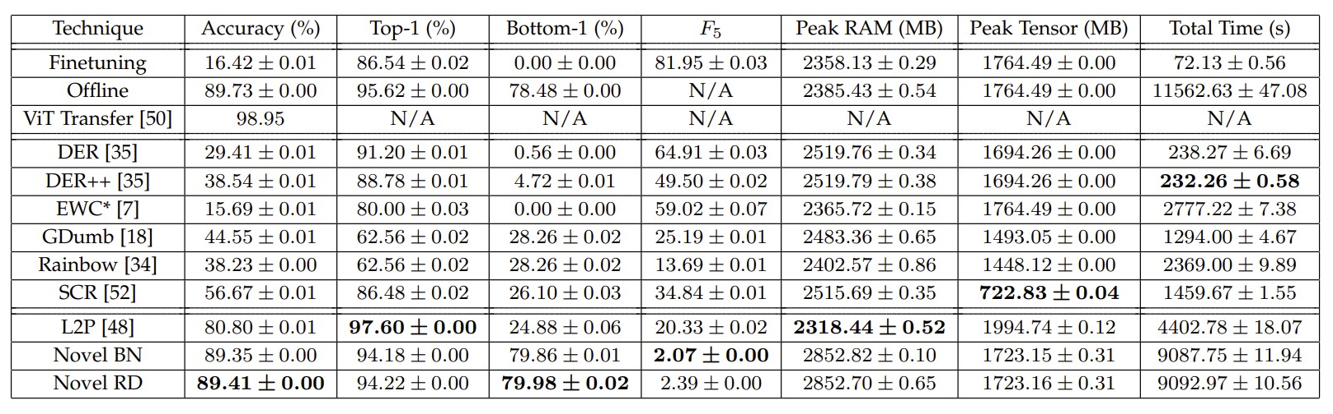
Full Results from CIFAR-10

Slide 29
Applications of Continual Learning
Combining historical and new data together
Medical imaging → real time

